Slide 1


CAPSTONE PROJECT MySQL
ARVIND K

Slide 2
PROJECT INTRODUCTION
The objective of the Capstone is to demonstrate the ability to use
MySQL
Python
Tableau
We are provided with different business scenarios that we need to analyze using these three technologies, explain our methodology and derive a conclusion
MySQL
python
tableau

Slide 3
DESCRIPTION OF DATASET
A certain bank in North America wants to perform customer churn analysis, as the credit card business of the bank is not performing very well. Churn analysis will help the bank evaluate the customers who have stopped purchasing the credit card of the bank and figure out measures to reduce the bank’s customer loss rate
We use the data provided in CSV format to perform the required analysis
The data contains 22 columns with data related to customer details, transaction details and attrition details

Slide 4
DATA DICTIONARY
CLIENTNUM: Client number. Unique identifier for the customer holding the account.
Attrition_Flag: Internal event (customer activity) variable. If the account is closed, then it is 1, otherwise it is 0.
Customer_Age: Demographic variable - Customer's age in years
Gender: Demographic variable - M=Male, F=Female
Dependent_count: Demographic variable - Number of dependents
Education_Level: Demographic variable - Educational qualification of the account holder (example: high school, college graduate, etc.)
Marital_Status: Demographic variable - Married, Single, Divorced, Unknown
Income_Category: Demographic variable - Annual income category of the account holder (< $40K, $40K - 60K, $60K - $80K, $80K-$120K, > $120K, Unknown)
Card_Category: Product Variable - Type of card (Blue, Silver, Gold, Platinum)
Region: The region to which the account holder belongs
Card_Category: Product Variable - Type of card (Blue, Silver, Gold, Platinum)
Region: The region to which the account holder belongs
Months_on_book: The period since the loan is purchased
Total_Relationship_count: Years of relationship with the bank
Months_Inactive_12_mon: Months of inactivity in the last 12 months
Contacts_Count_12_mon: Contact made by bank in the last 12 months
Credit_Limit: Credit limit offered by the bank on the card
Total_Revolving_Bal: Balance that carries over month to month
Avg_Open_to_Buy: Difference between the credit limit assigned to a card holder and the present balance on the account
Total_Trans_Amt: The total amount transacted by the customer
Total_Trans_Ct: The total number of transactions by the card holder(Last 12 months).
Average_Utilzation_Ratio: Utilization of card and calculated average

Slide 5
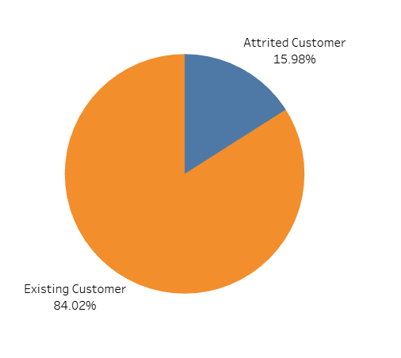
TASK 1
Percentage of the attrited and the existing customer from the data
INTERPRETATION
15. 98% are attrited from the bank which makes the percentage of existing customers 84.02%

Slide 6
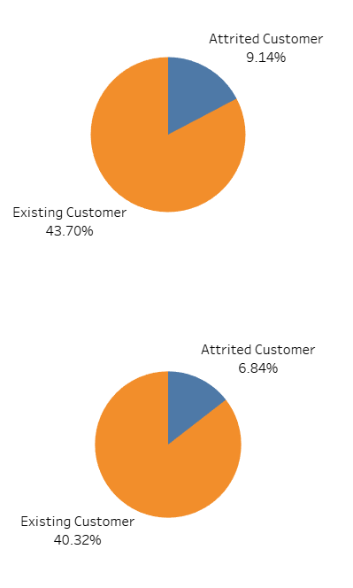
TASK 2
Gender Wise percentage of the attrited and the existing customer
F
INTERPRETATION
The percentage of attrition is higher in women than men
M

Slide 7
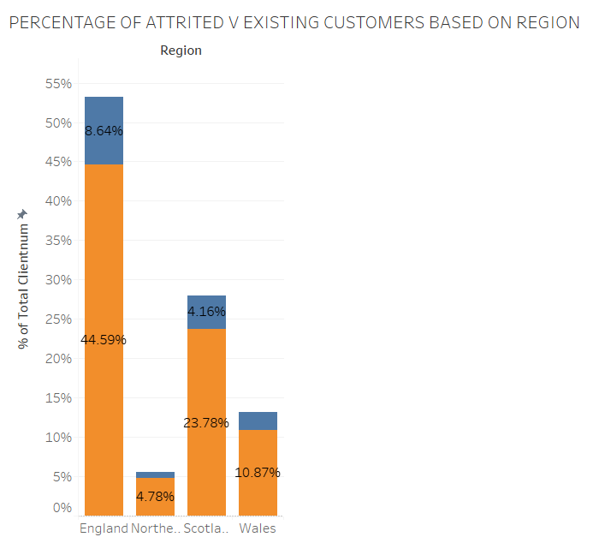
TASK 3
Region wise percentage of the attrited and the existing customer
INTERPRETATION
England has the most existing and attrited customers whereas Northern Ireland has the least

Slide 8
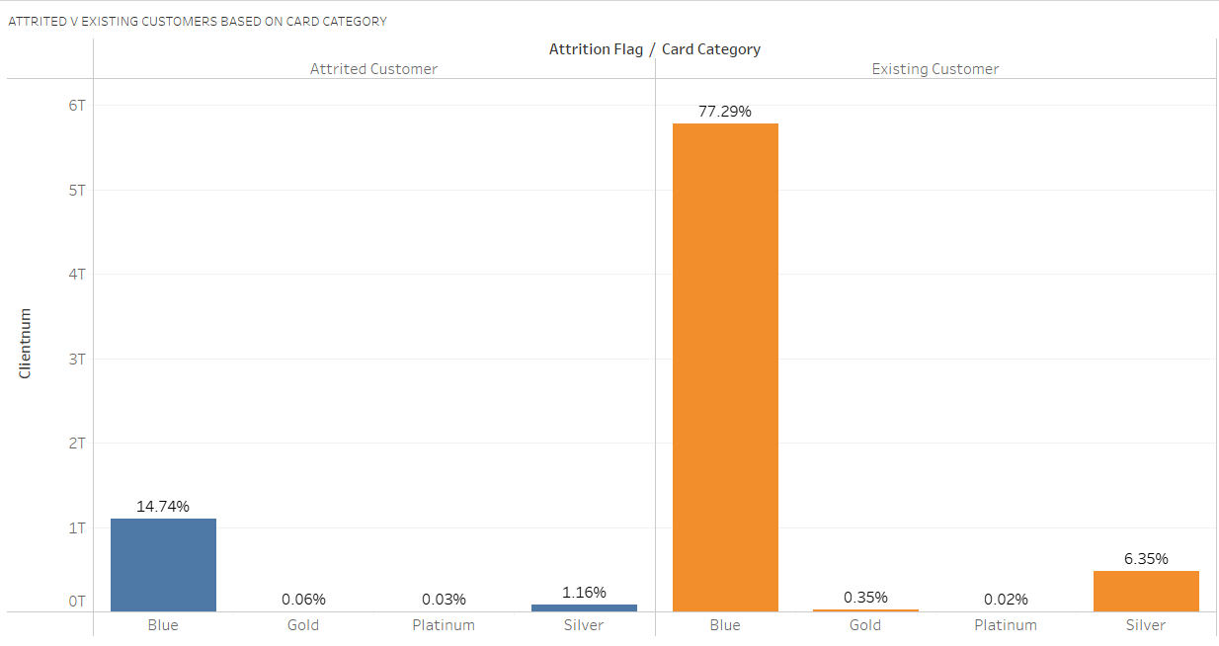
TASK 4
Card Category wise percentage of the attrited and the existing customer
INTERPRETATION
Most of the customers are Blue card holders and hence they are the most Existing and Attrited customers

Slide 9
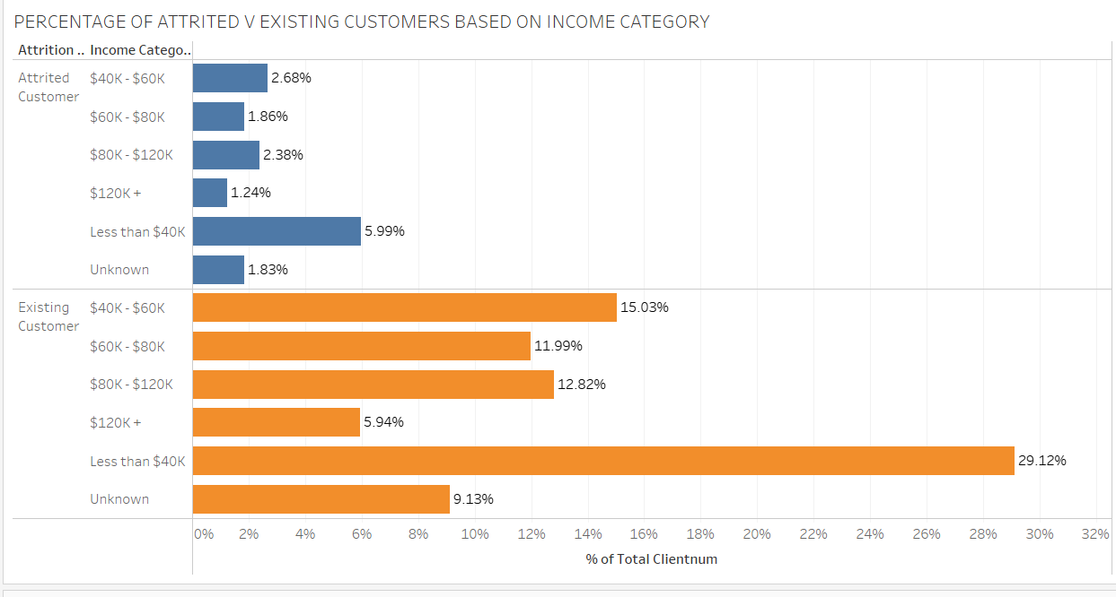
TASK 5
INTERPRETATION
Most of the attrited customers are those who are earning less than $40K and least attrition is seen in customers earning more than $120K
Income Category wise percentage of the attrited and the existing customers

Slide 10
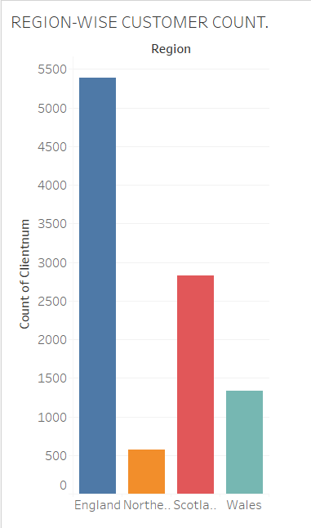
TASK 6
Region wise customer count
INTERPRETATION
More than 5000 customers from England prefer this bank and hence it has the most number of customers when compared to other regions

Slide 11
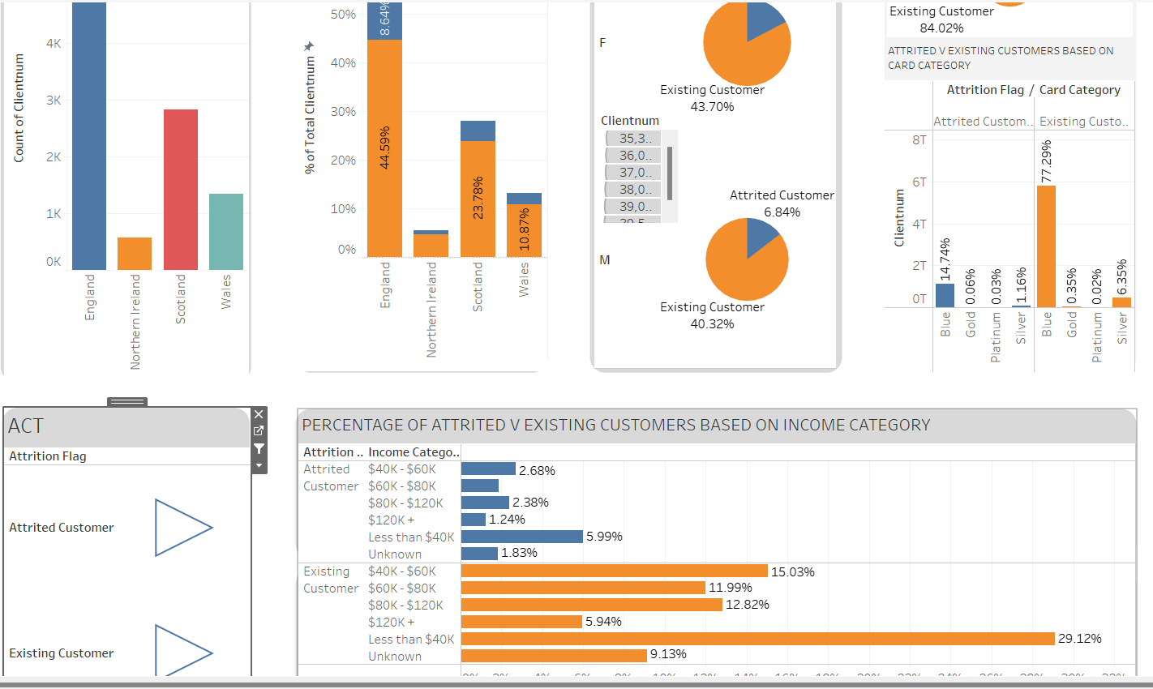
DASHBOARD

Slide 12
THANK YOU

